Slide 1





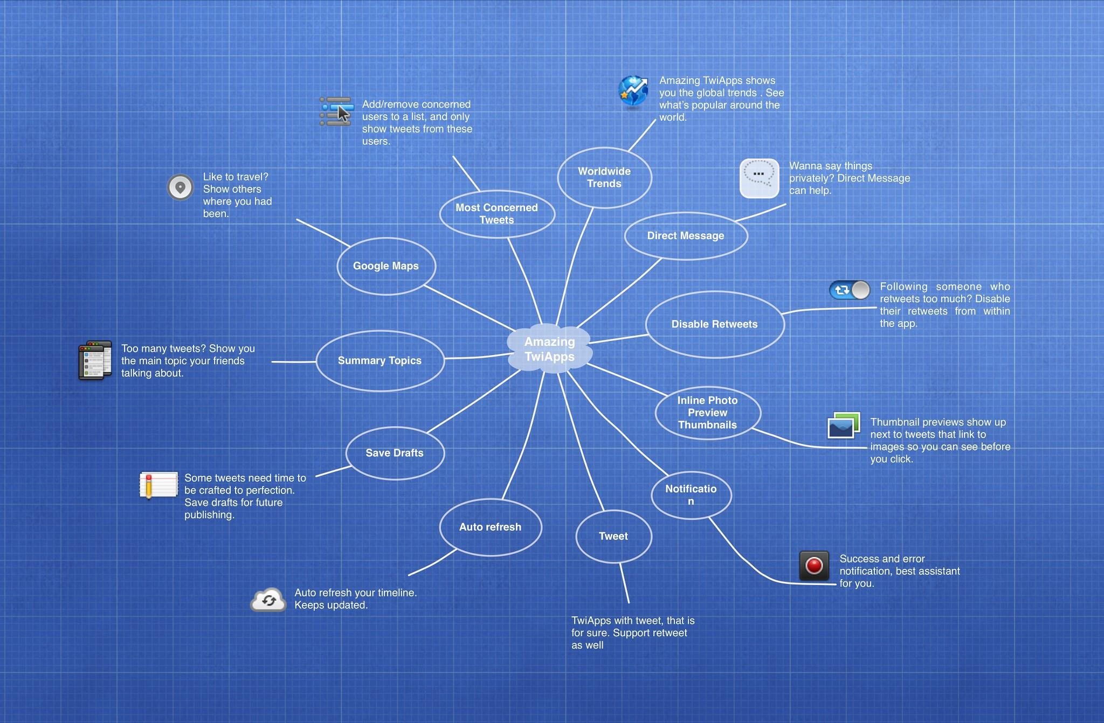
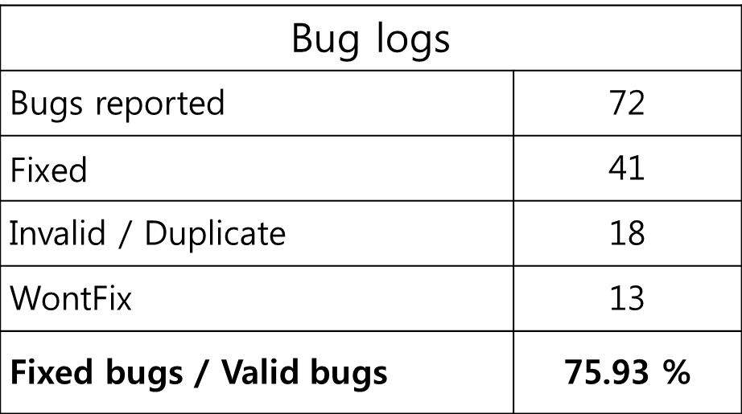
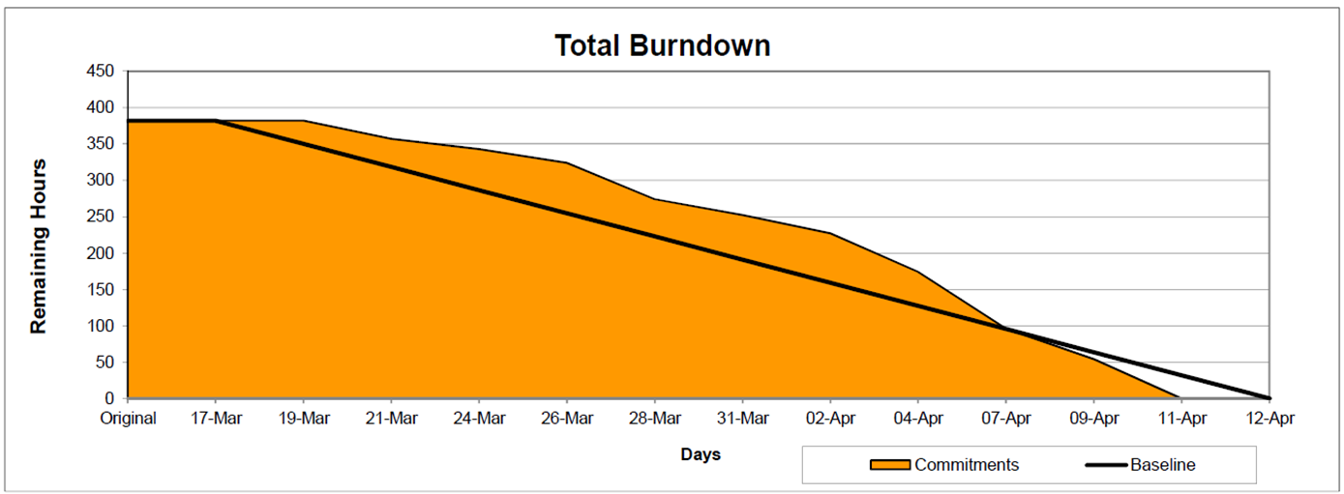
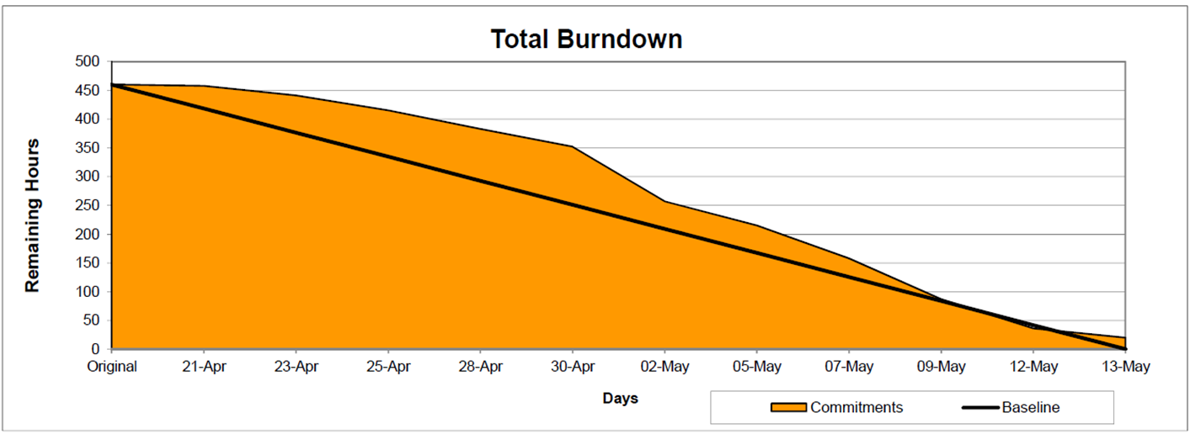
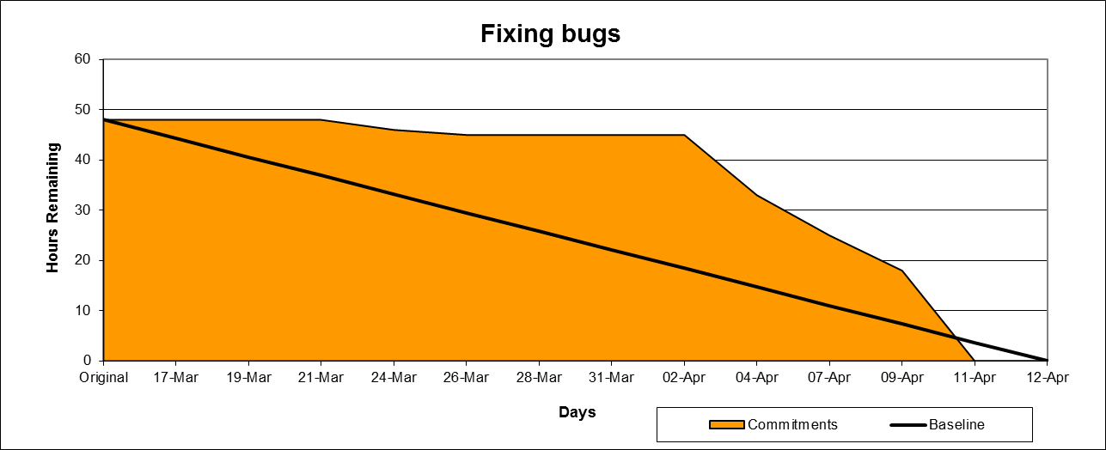
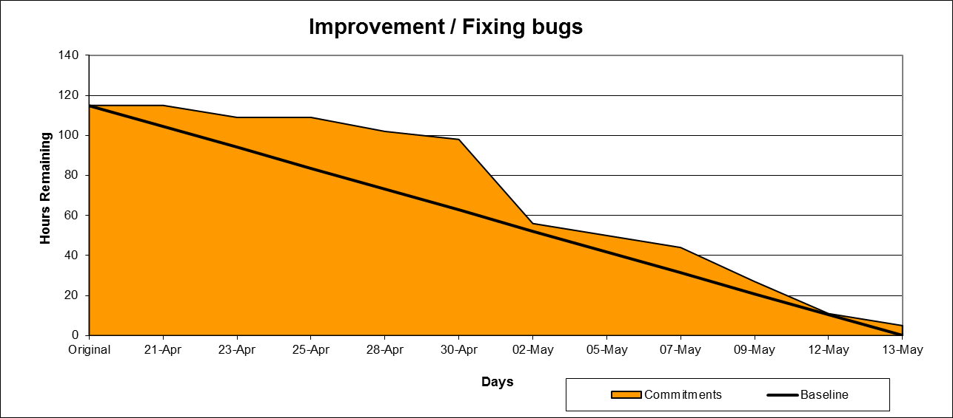
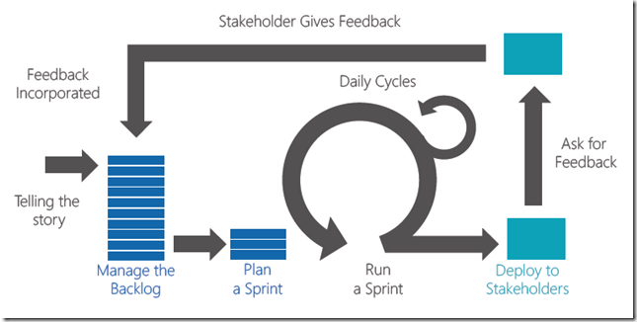
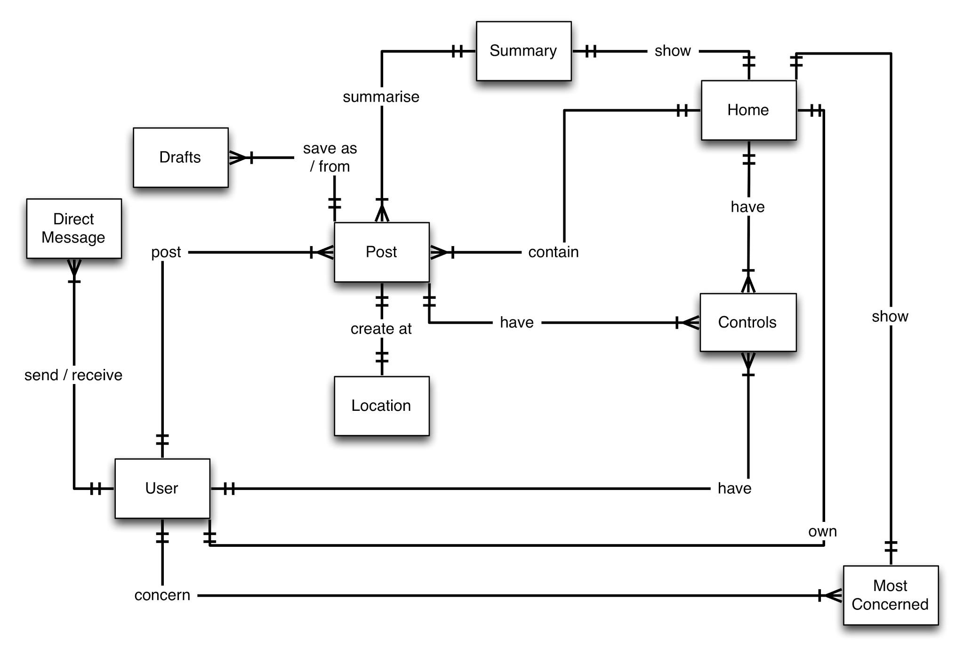
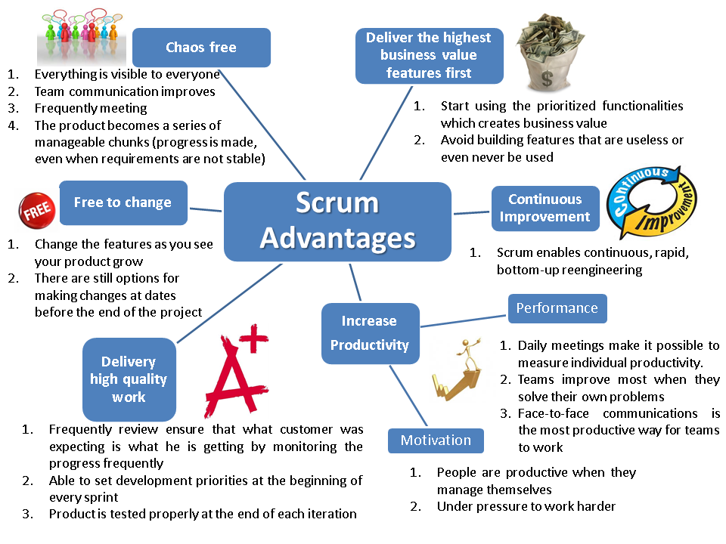
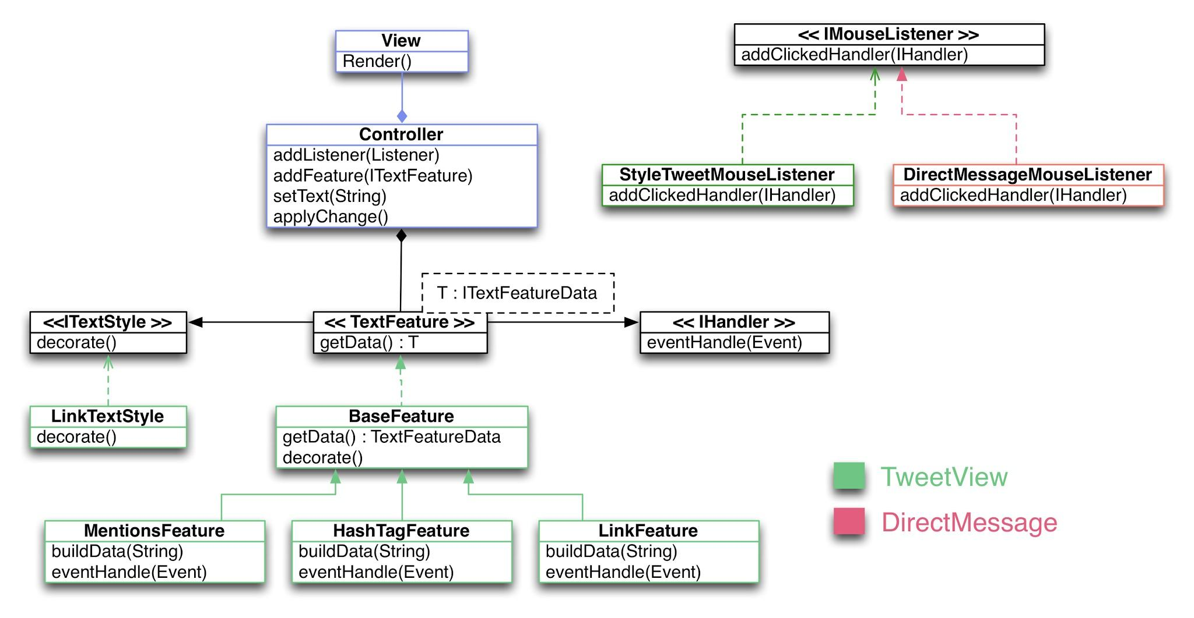

Amazing TwiApps to survive in the overflow of tweets
The Hong Kong University of Science and Technology
Pohang University of Science and Technology
COMP 3111
Team 210
Chan Ka Yue, Martin | Mar Chun Sum, Connie | Lui Kwan Ho | Jiyong Park
Cheung Shing Cheong, Chris |  | Lung Tin Leung, Tony
Development Plan
Program Features
Test plans/Bug logs
1. Test objective - Since users are most interested in the system to meet its requirements, we planned tests so that all requirements are individually tested. It can be measured as “code coverage”. Our test objective is to get higher coverage in order to all requirements (all classes) are individually tested.
For whom??
2. The bugs reporting - We had reported all possible bugs on our project web pages, and tried to fix them as many as possible. And we integrated Findbugs with Continuous Integration (CI), and tried to pursue to fix the warning of Findbugs.
3. Testing process - Since TDD guarantees high coverage of testing, we tried to pursue Test Driven Development (TDD) for our project to achieve test objective. We tested periodically using CI. CI also allowed the project to be tested whenever some codes are modified.
4. Bug fixing schedule - In phase 1, we fixed most reported bugs after implementing all features required. Then we found that it was more complicated to fix bugs after implementation than before. Therefore we tried to fix bugs as soon as possible, before implementing features required.
<Phase1 Burndown Chart> <Phase2 Burndown Chart>
<Phase1 Fixing bugs> <Phase2 Fixing bugs>
Development Process
Features Design
Lesson Learned
<Save draft>
We applied the popular unsupervised model, Latent Dirichlet Allocation (LDA) because LDA has been applied widely to text modeling.
This model extracts collections of text documents (tweets) into distributions of words that tend to co-occur in similar documents - these sets of related words are referred to as "topics". We implemented LDA using the open source “MALLET: A Machine Learning for Language Toolkit”.
- Future Works
While LDA works well on many documents, it seems not working well on tweets. We concluded that LDA doesn’t work well on documents as short as mircoblogs such as Twitter and Facebook. Tweets are short and different from news articles or paper abstracts.
We guess that Labeled LDA, which extends LDA with supervision, could work better on tweets. However we should study more on characteristics of microblogs different from usual documents.
==
<Summary Topics>
We applied the popular unsupervised model, Latent Dirichlet Allocation (LDA) because LDA has been applied widely to text modeling.
This model extracts collections of text documents (tweets) into distributions of words that tend to co-occur in similar documents - these sets of related words are referred to as "topics". We implemented LDA using the open source “MALLET: A Machine Learning for Language Toolkit”.
- Future Works
While LDA works well on many documents, it seems not working well on tweets. We concluded that LDA doesn’t work well on documents as short as mircoblogs such as Twitter and Facebook. Tweets are short and different from news articles or paper abstracts.
We guess that Labeled LDA, which extends LDA with supervision, could work better on tweets. However we should study more on characteristics of microblogs different from usual documents.
- Software is so buggy!
- Fixing bug is one of the most important jobs for SW engineer
- Process is burdensome at first, but process lightens the burden finally
- There are many tools and techniques helping us such as Eclipse, SVN, CI, ant, randoop, findbugs and debugger.
- Testing is as important as implementing
- Be not only programmer but also designer
- Good design makes the application to be extended easily
- Maintainability is really important for SW
- Time management and prioritizing are essential
for the SW development
- Frequent team meeting makes the application better
- The most important thing for success of project is ‘corporation’
- Impossible is nothing
- Love Sung ☺
QR Code
for project web page

